Slide 1


Wonder Woman 1984

Slide 2
1
Intro Information Workshops
2
What is Android Jetpack Compose?
3
Understand Android Jetpack Compose
Declarative Programming paradigm
Agenda
Declarative paradigm shift
Lifecycle
Running with Jetpack Compose
Components
Themes
4
Demo
5
Conclusion
6
Q&A

Slide 3



What is Android Jetpack Compose? Go to www.menti.com and use the code
Jetpack Compose
Notes:
For those that don’t know…
Jetpack is a suite of libraries to help developers follow best practices, reduce boilerplate code, and write code that works consistently across Android versions and devices so that developers can focus on the code they care about.

Slide 4

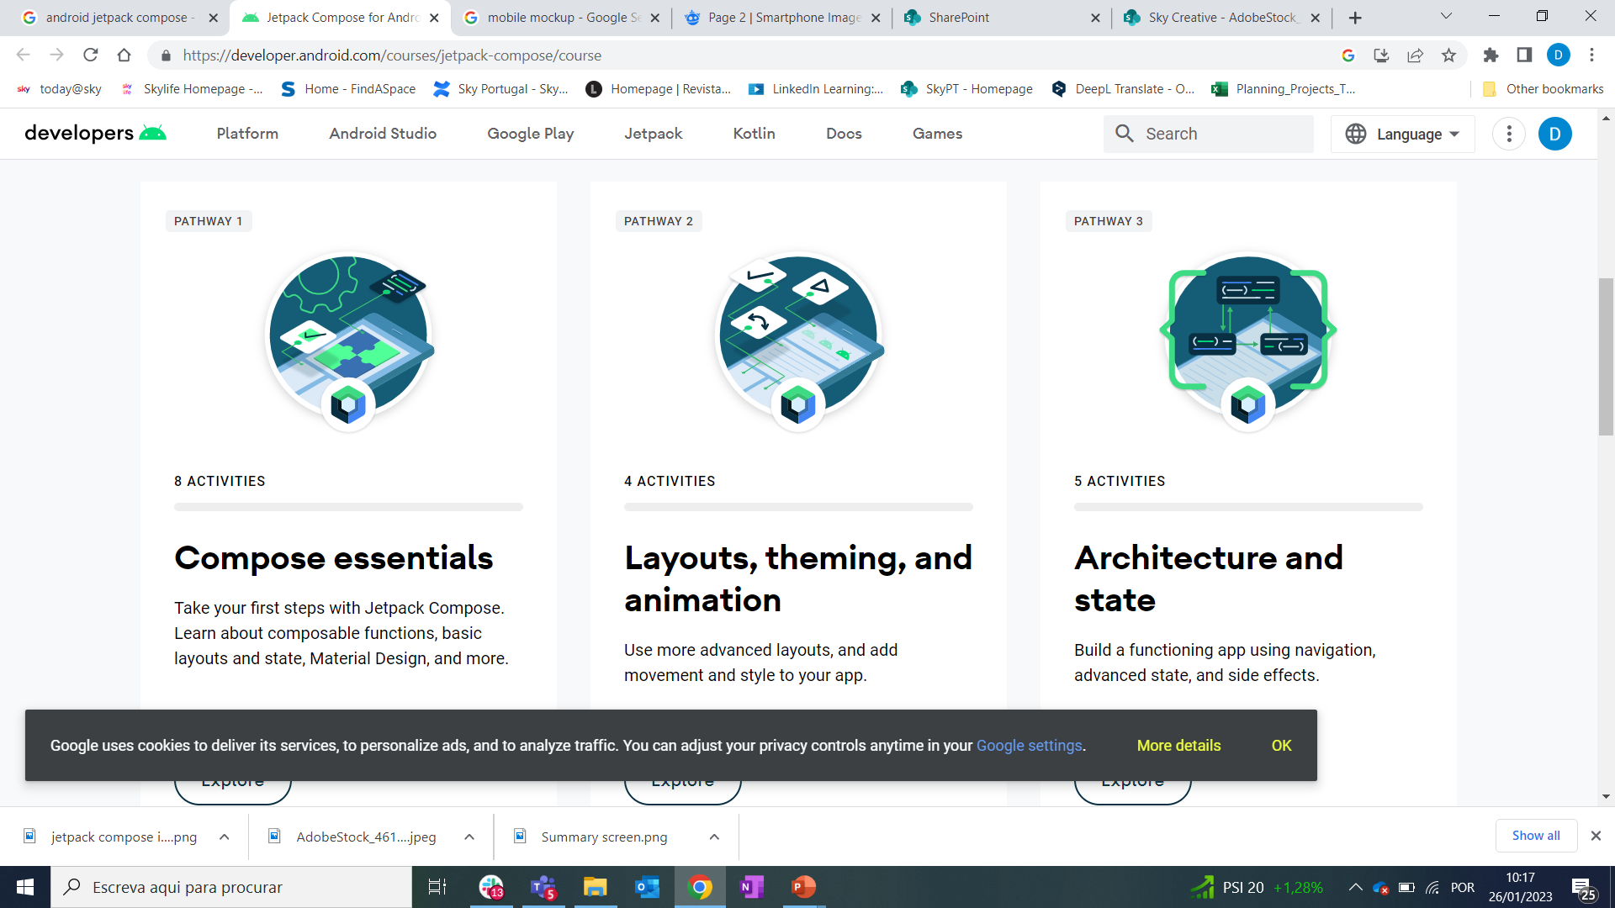
Android Jetpack Compose
Jetpack Compose is Android’s modern toolkit for building native UI.
It simplifies and accelerates UI development on Android. Quickly bring your app to life with less code, powerful tools, and intuitive Kotlin APIs.
Notes:
For those that don’t know…
Jetpack is a suite of libraries to help developers follow best practices, reduce boilerplate code, and write code that works consistently across Android versions and devices so that developers can focus on the code they care about.
We were using XML layouts to build the native UI. We had a very dependent structure when we build the screens with XML. Also, fragments are very heavy components for the UI. Jetpack Compose allows us to build the same UI with a declarative UI approach and with less code.

Slide 5

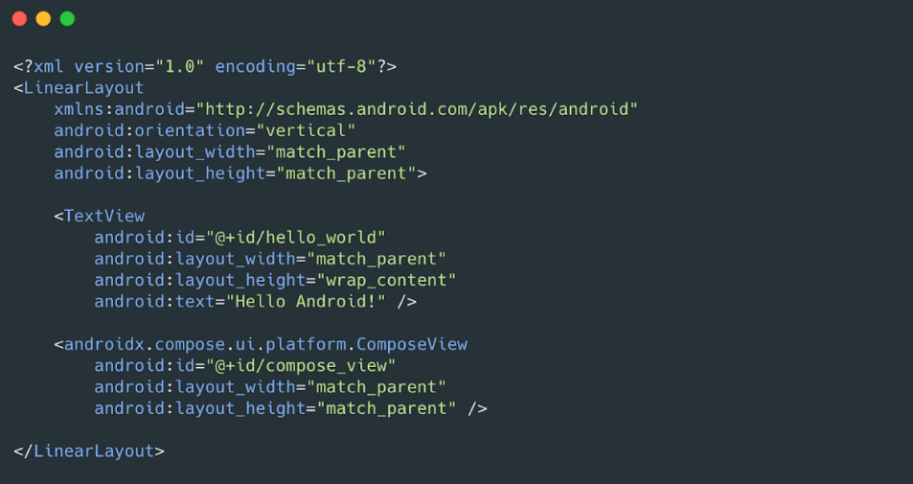
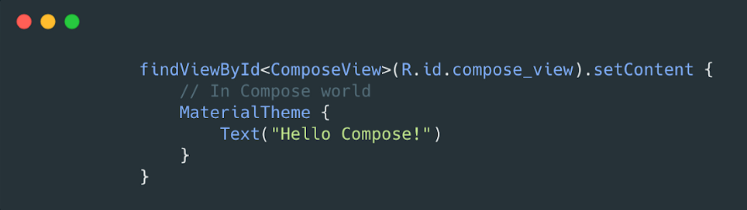
Android Jetpack Compose What is Android Jetpack Compose?
Less Code
Do more with less code and avoid entire classes of bugs, so code is simple and easy to maintain.
Easy to review and understand
Only in Kotlin, rather than having it split between Kotlin and XML
Notes:
Intuitive : With Compose, you build small, stateless components that are not tied to a specific activity or fragment.
In Compose, state is explicit and passed to the composable.
That way there’s one single source of truth for the state, making it encapsulated and decoupled. Then, as app state changes, your UI automatically updates
Accelerate Development:
Most common libraries like Navigation, ViewModel and Kotlin coroutines work with Compose, so you can start adopting when and where you want
No more recyclerViews
Powerful: bringing movement and life to your apps through animations is quick and easy to implement

Slide 6
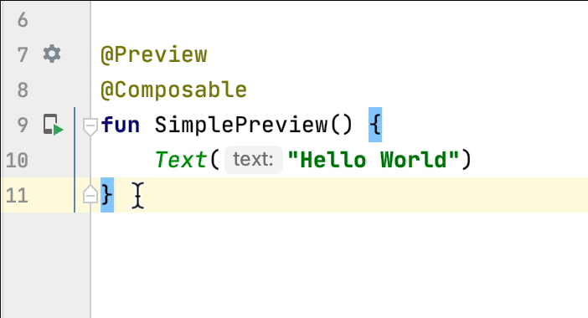
Android Jetpack Compose What is Android Jetpack Compose?
Intuitive
Just describe your UI, Compose takes care of the rest.
As App State changes, your UI automatically updates.
Accelerate Development
Compatible with all existing code, so you can adopt when and where you want.
Iterate fast with live previews and full Android Studio support.
Powerful
Create beautiful Apps with direct access to the Android platform APIs and built-in support for Material design, Dark Theme, animations and more.
Notes:
Intuitive : With Compose, you build small, stateless components that are not tied to a specific activity or fragment.
In Compose, state is explicit and passed to the composable.
That way there’s one single source of truth for the state, making it encapsulated and decoupled. Then, as app state changes, your UI automatically updates
Accelerate Development:
Most common libraries like Navigation, ViewModel and Kotlin coroutines work with Compose, so you can start adopting when and where you want
No more recyclerViews
Powerful: bringing movement and life to your apps through animations is quick and easy to implement

Slide 7

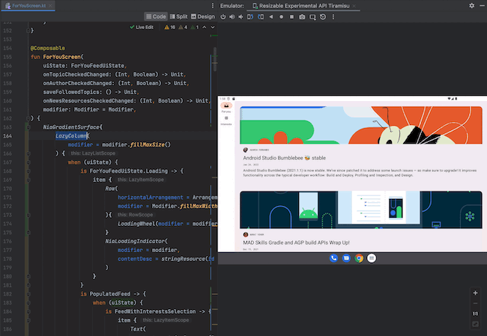
Android Jetpack Compose What is Android Jetpack Compose?

Slide 8
Android Jetpack Compose The declarative programming paradigm
Android view hierarchy has been representable as a tree of UI widgets.
As the state of the app changes because of things like user interactions, the UI hierarchy needs to be updated to display the current data.
The most common way of updating the UI is to walk the tree using functions like findViewById(),
change nodes by calling methods like button.setText(String), container.addChild(View), or img.setImageBitmap(Bitmap).
These methods change the internal state of the widget.
Likelihood of errors
Piece of data is rendered in multiples places
Creation of illegal States
Ex: Try to set a value of a node that was just removed from the UI
In Compose declarative approach, widgets are relatively stateless and do not expose setter or getter functions. In fact, widgets are not exposed as objects. You update the UI by calling the same composable function with different arguments.
Notes:
Manipulating views manually increases the likelihood of errors. If a piece of data is rendered in multiple places, it’s easy to forget to update one of the views that shows it. It’s also easy to create illegal states, when two updates conflict in an unexpected way. For example, an update might try to set a value of a node that was just removed from the UI.

Slide 9

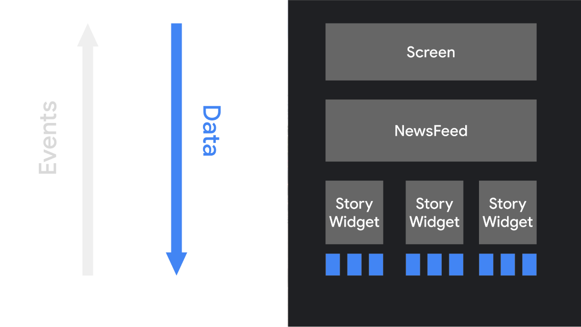
Android Jetpack Compose The declarative paradigm shift
Widgets are relatively stateless and do not expose setter or getter functions.
Widgets are not exposed as objects.
Update the UI by calling the same composable function.
Easy for architectural patterns such as ViewModel.
Composables are responsible for transform the current Application state into UI everytime the observable data updates.
Notes:
In Compose's declarative approach, widgets are relatively stateless and do not expose setter or getter functions. In fact, widgets are not exposed as objects.
You update the UI by calling the same composable function with different arguments. This makes it easy to provide state to architectural patterns such as a ViewModel. Then, your composables are responsible for transforming the current application state into a UI every time the observable data updates.
On image: The app logic provides data to the top-level composable function. That function uses the data to describe the UI by calling other composables, and passes the appropriate data to those composables, and on down the hierarchy.

Slide 10
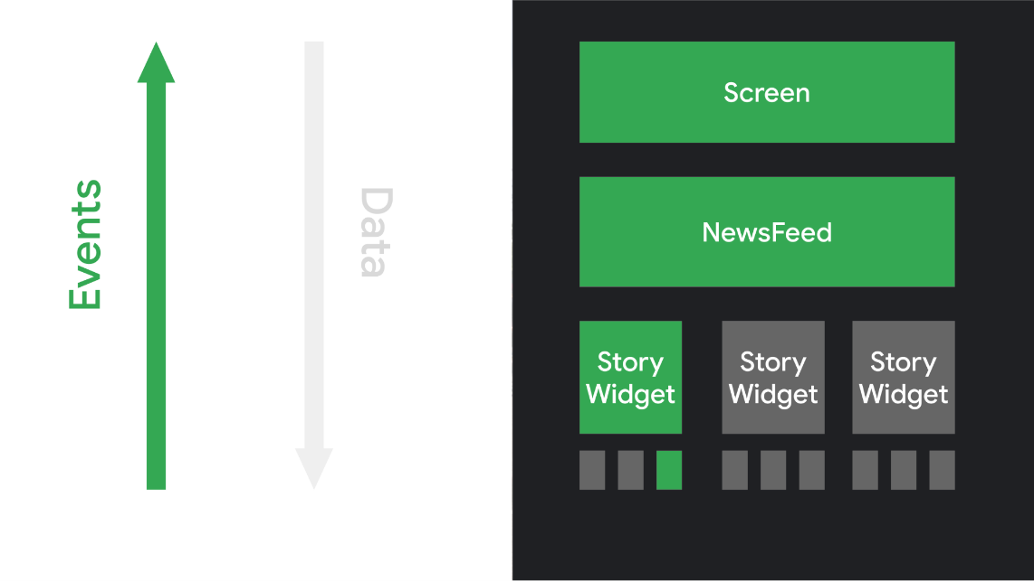
Android Jetpack Compose The declarative paradigm shift
When user interacts with the UI, the UI raises events such as onClick
Those events notify the app logic, which can then change the App state.
When the state changes, the composable functions are called again with new data.
Called as Recomposition.
Notes:
The user interacted with a UI element, causing an event to be triggered. The app logic responds to the event, then the composable functions are automatically called again with new parameters, if necessary.

Slide 11
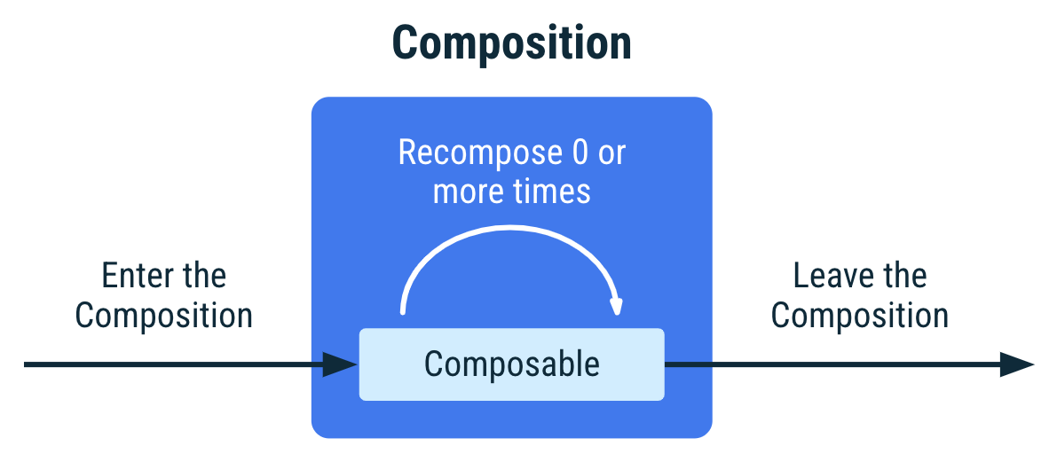
Android Jetpack Compose Understand Android Jetpack Compose - Lifecycle
Notes:
Lifecycle of a composable in the Composition. It enters the Composition, gets recomposed 0 or more times, and leaves the Composition.
Recomposition is typically triggered by a change to a State<T> object.
Compose tracks these and runs all composables in the Composition that read that particular State<T>, and any composables that they call that cannot be skipped.

Slide 12
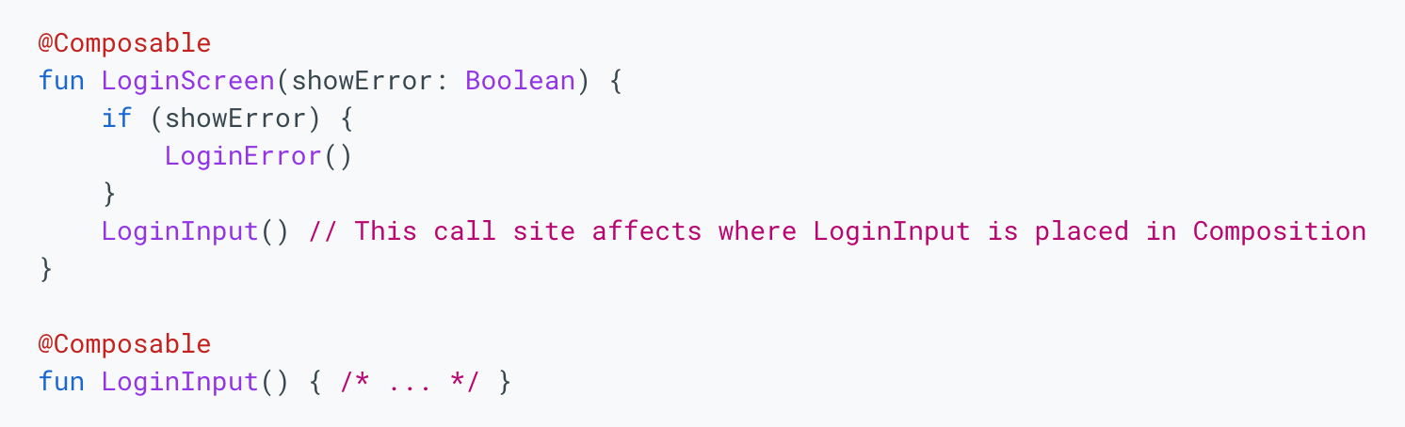
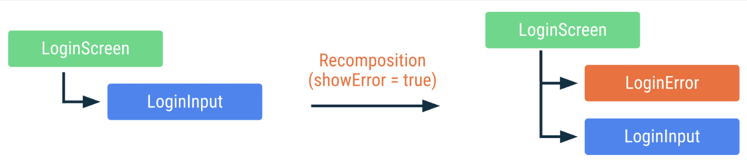
Android Jetpack Compose Understand Android Jetpack Compose - Lifecycle
Notes:
In the code snippet above, LoginScreen will conditionally call the LoginError composable and will always call the LoginInput composable. Each call has a unique call site and source position, which the compiler will use to uniquely identify it.
Figure 3. Representation of LoginScreen in the Composition when the state changes and a recomposition occurs. Same color means it hasn't been recomposed.

Slide 13

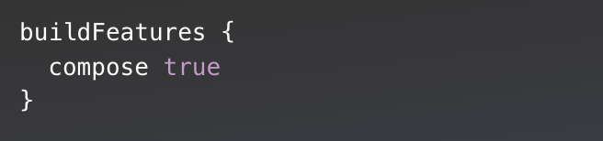
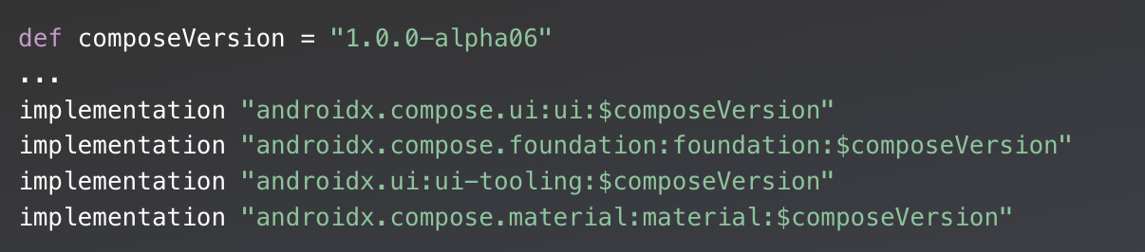
Android Jetpack Compose Running with Jetpack Compose
Dependencies:
app/build.gradle
Notes:
Compose isn’t just one library that you import, it includes a suite of different libraries for different UI constructs you may want to use. In this project, you’re using the basic building blocks that you’ll need to build a basic layout.
In addition to those dependencies, you can see that the compose flag is set to true, in the buildFeatures block within android:
Androidx.compose.ui - Fundamental components of compose UI needed to interact with the device, including layout, drawing, and input.
androidx.compose.foundation - Write Jetpack Compose applications with ready to use building blocks and extend foundation to build your own design system pieces.
androidx.compose.material - Build Jetpack Compose UIs with ready to use Material Design Components.

Slide 14
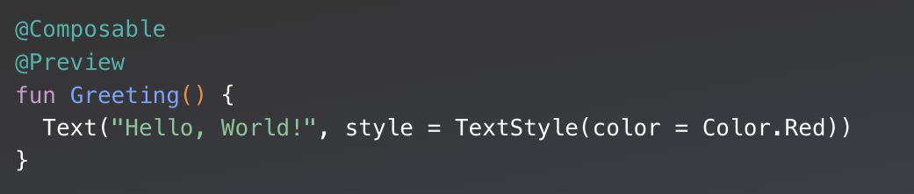
Android Jetpack Compose Running with Jetpack Compose

Slide 15
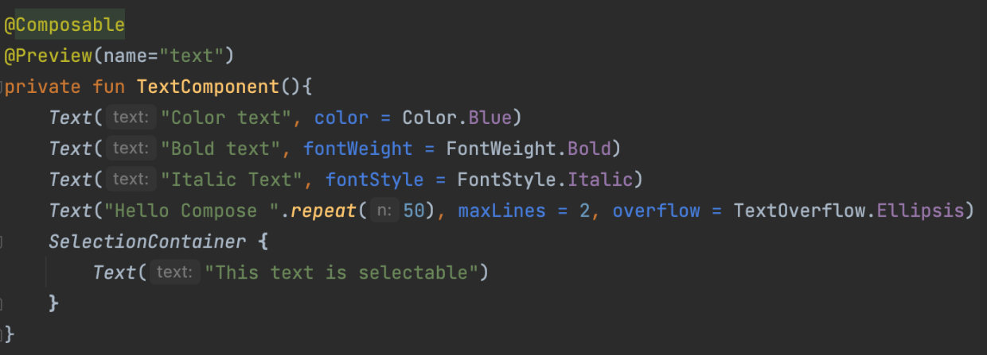
Android Jetpack Compose Basic Components
Notes:
When limiting a long text, you may want to indicate a text overflow, which is only shown if the displayed text is truncated. To do so, set the textOverflow parameter:
By default, composables aren’t selectable, which means by default users can't select and copy text from your app. To enable text selection, you need to wrap your text elements with a SelectionContainer composable:

Slide 16
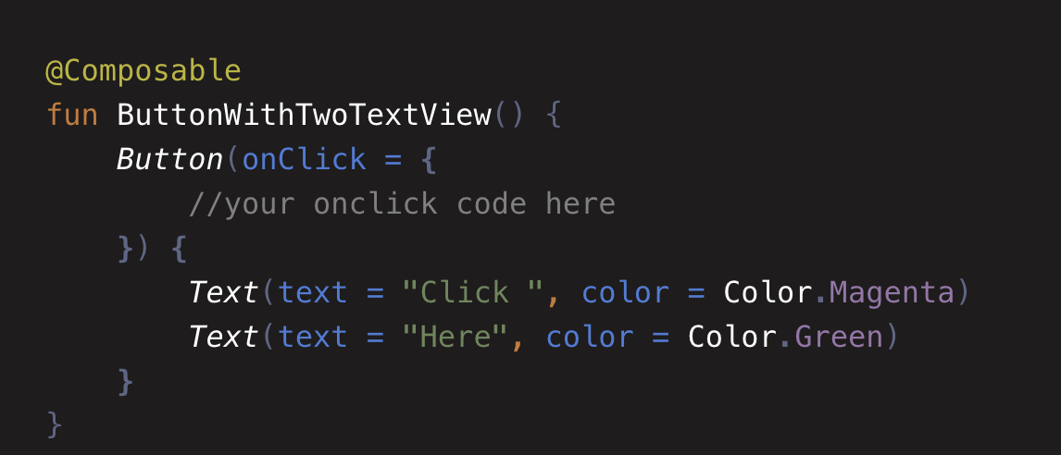

Android Jetpack Compose Basic Components
Button

Slide 17

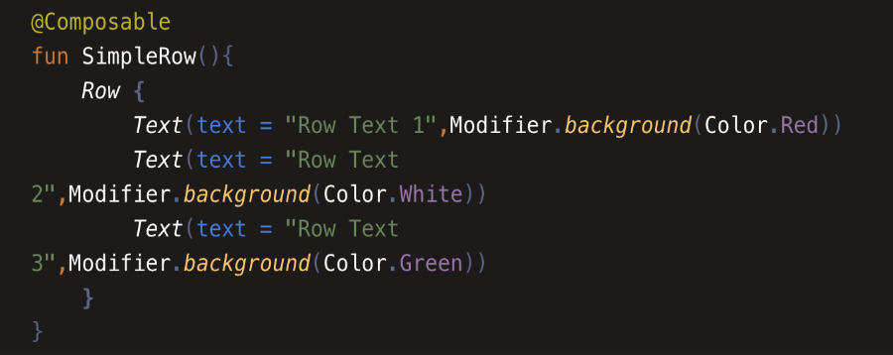
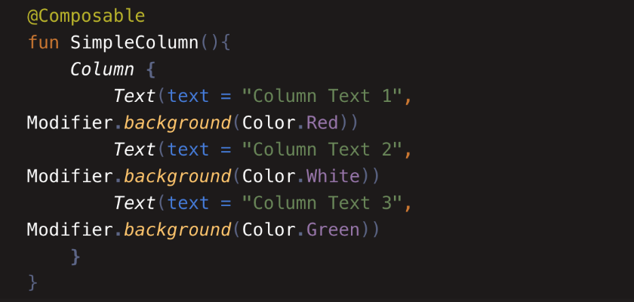
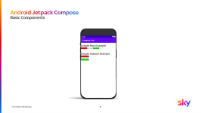
Android Jetpack Compose Basic Components
Row – It arranges the views horizontally
Column - It arranges the view vertically

Slide 18

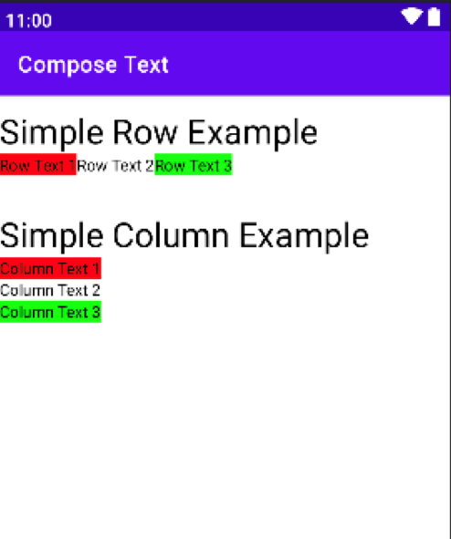
Android Jetpack Compose Basic Components
Notes:
If you need to display a large number of items (or a list of an unknown length), using a layout such as Column can cause performance issues, since all the items will be composed and laid out whether or not they are visible.
Compose provides a set of components which only compose and lay out items which are visible in the component’s viewport. These components include LazyColumn and LazyRow.
LazyListScope.

Slide 19
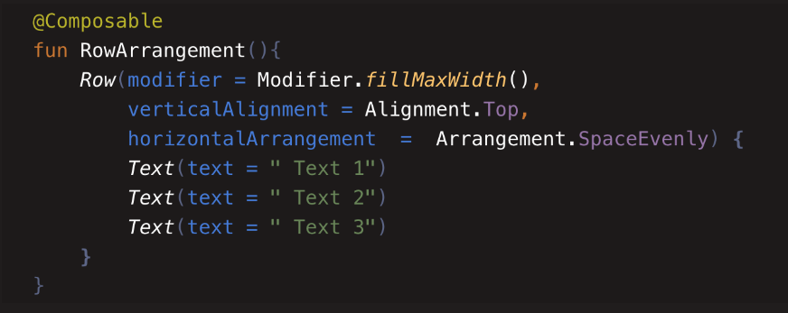
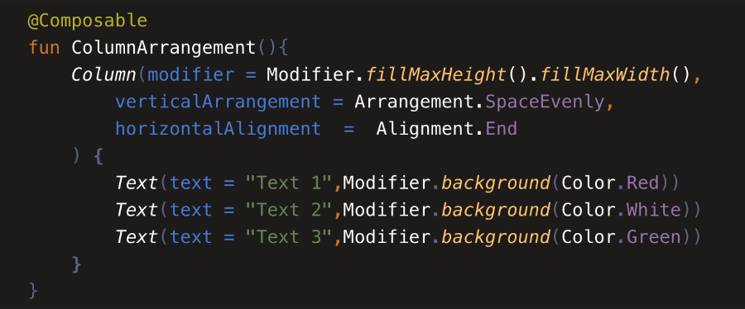
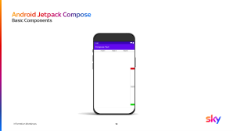
Android Jetpack Compose Basic Components
Row – It arranges the views horizontally
Column - It arranges the view vertically

Slide 20
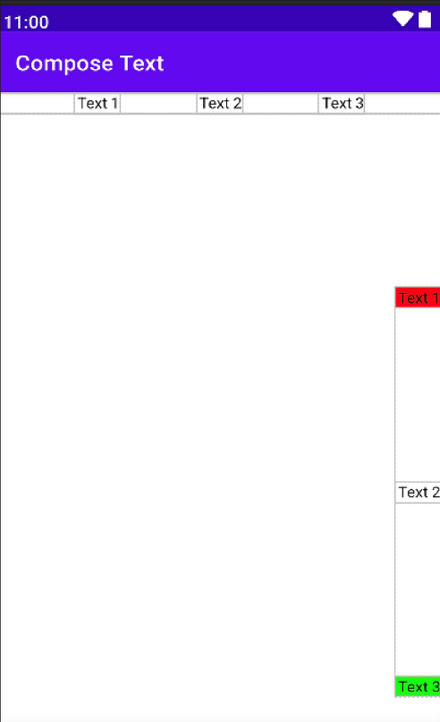
Android Jetpack Compose Basic Components
Notes:
If you need to display a large number of items (or a list of an unknown length), using a layout such as Column can cause performance issues, since all the items will be composed and laid out whether or not they are visible.
Compose provides a set of components which only compose and lay out items which are visible in the component’s viewport. These components include LazyColumn and LazyRow.
LazyListScope.

Slide 21
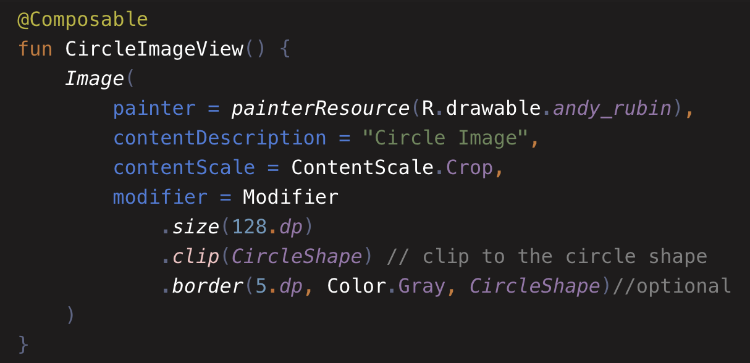

Android Jetpack Compose Basic Components
Image
Notes:
Content Scale can be:
FillBounds
FillHeight
FillWidth
Inside
Fit
Crop

Slide 22
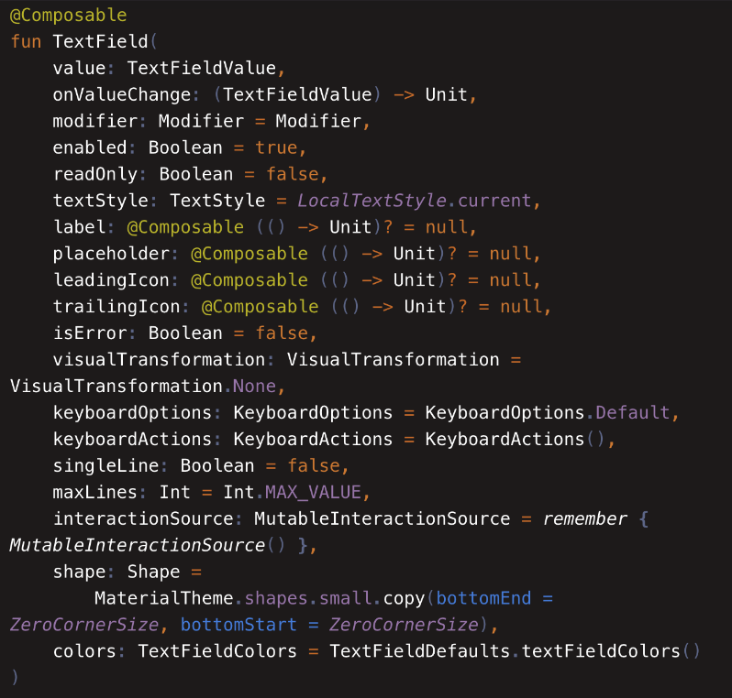
Android Jetpack Compose Basic Components
TextField
TextField is a user interface control that is used to allow the user to enter the text. This widget is used to get the data from the user as numbers or text.
As Android Developer…. It’s EditText!

Slide 23
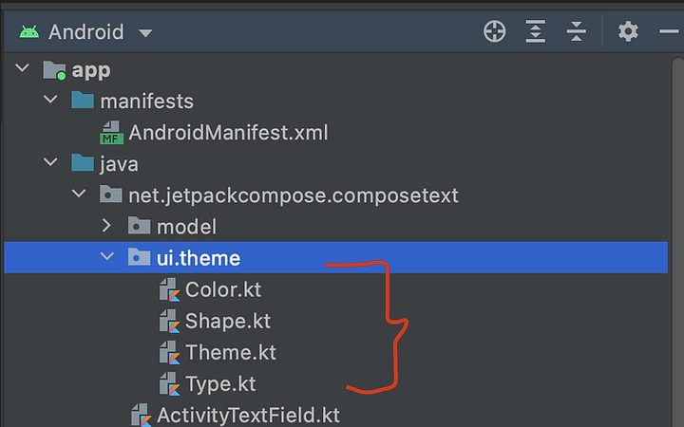
Android Jetpack Compose Themes
If you create a new Jetpack compose project, you will see ui.theme package.
It contains the following classes:
Color.kt - for custom colors
Shape.kt - for custom shapes
Type.kt - for custom typography
Theme.kt - for custom themes

Slide 24

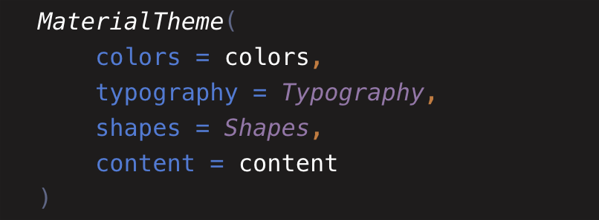
Android Jetpack Compose Themes
Material Theme
A Material Theme defines the styling principles from the Material Design specification. In Jetpack Compose, MaterialTheme is available as a composable function with which we can customize the default attributes.
A Material Theme comprises color, typography and shape attributes. When you customize these attributes, it automatically reflected your changes in the components.
Notes:
The Material Design components (buttons, cards, switches, and so on) are built on top of Material Theming, which is a systematic way to customize Material Design to better reflect the product’s brand

Slide 25

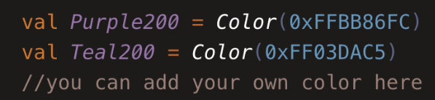
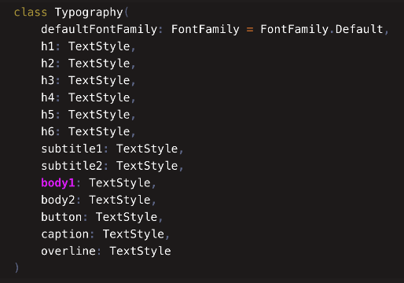
Android Jetpack Compose Themes
Colors.kt
First two characters 0x tell the compiler that this is a hexadecimal number.
Second two characters, "FF" represent Transparency/Alpha in Hex.
The remaining six character pairs represent Red, Green, and Blue.
Typography (Type.kt)
Notes:
(Type.kt)The Material Design components (buttons, cards, switches, and so on) are built on top of Material Theming, which is a systematic way to customize Material Design to better reflect the product’s brand

Slide 26
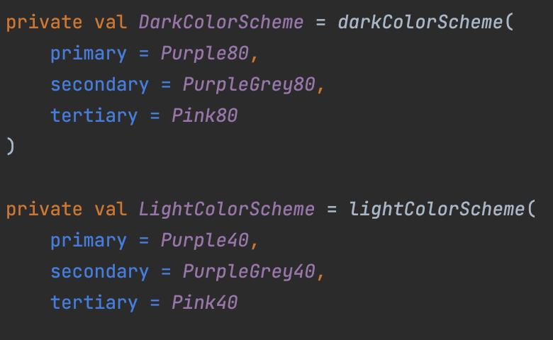
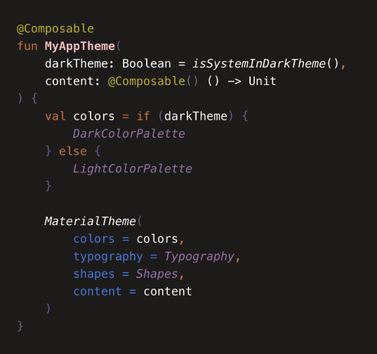
Android Jetpack Compose Themes
Dark and Light Theme
Jetpack Compose provides two default functions:
darkColorScheme() – for Dark Mode
lightColorSheme() – for LightMode
Notes:
Apply these changes in Theme.kt file.

Slide 27
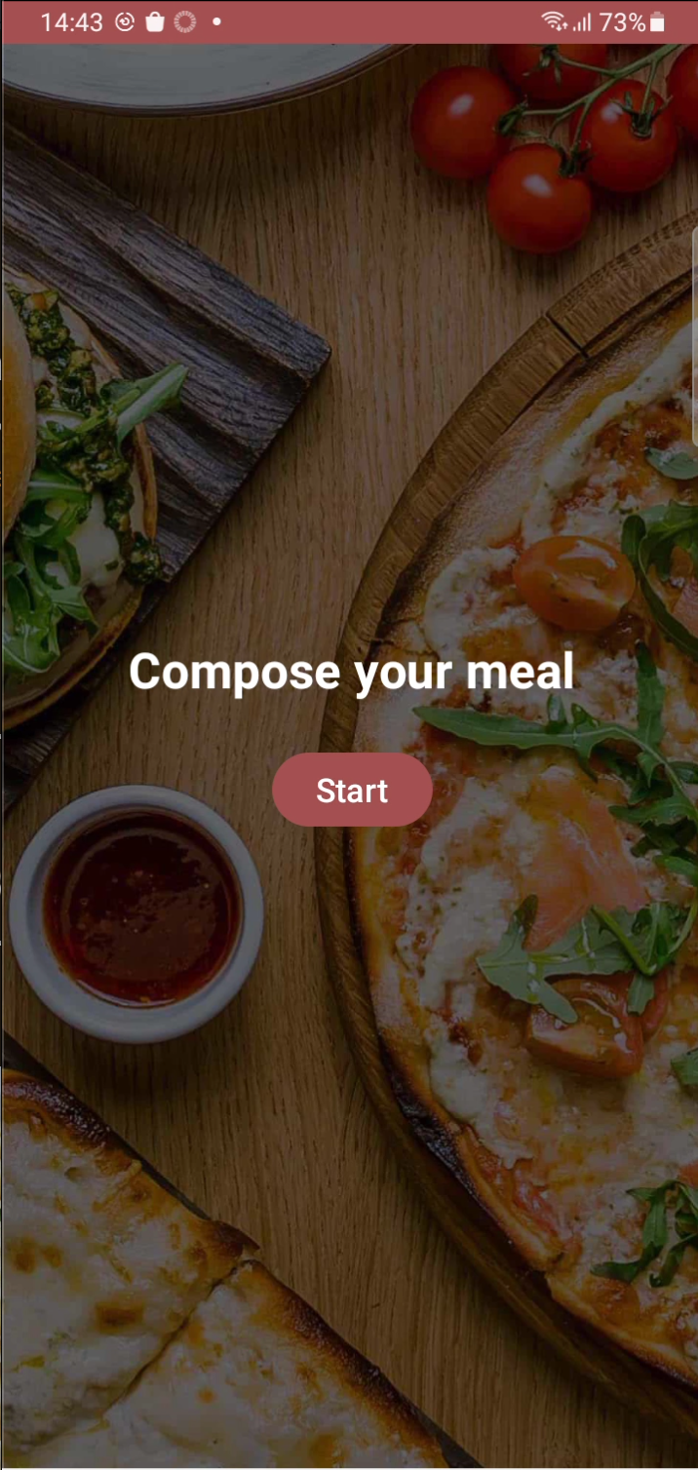
Android Jetpack Compose Demo
https://github.com/sky-carlos-peixoto/TechTalks-Compose
Notes:
Less code compared to XML
More understandable than XML
Managing State which allow as to manage the view’s state
Compatible to All the code
Fast development and Fast to Run as we have more efficiency to build layouts and with the recomposition of Compose, only each part of UI state that changes it changes. Everything else remains.

Slide 28
Android Jetpack Compose Conclusion
Jetpack Compose is a ”great” new way of Android UI development.
Less Code
More understandable code
Managing State
Compatible to all existing code
No Adapters! :D with lazyRow and lazyColumn
Fast development and fast to run… (as seen on internet)
Notes:
Less code compared to XML
More understandable than XML
Managing State which allow as to manage the view’s state
Compatible to All the code
Fast development and Fast to Run as we have more efficiency to build layouts and with the recomposition of Compose, only each part of UI state that changes it changes. Everything else remains.

Slide 29

Android Jetpack Compose
Q&A
Questions?

Slide 30

Thank you!
Questions?

Slide 31

Bibliography
https://developer.android.com/jetpack/compose
https://developer.android.com/codelabs/jetpack-compose-basics
https://developer.android.com/codelabs/basic-android-kotlin-compose-viewmodel-and-state#4
https://medium.com/androiddevelopers/understanding-jetpack-compose-part-1-of-2-ca316fe39050
https://www.jetpackcompose.net
https://www.raywenderlich.com/31473074-interoperability-with-jetpack-compose
https://github.com/vinaygaba/Learn-Jetpack-Compose-By-Example
https://github.com/android/compose-samples
https://blog.kotlin-academy.com/say-hello-to-jetpack-compose-and-compare-with-xml-6bc6053aec13

